Slide 1
System Programming
Software Development: g++ and make

Slide 2
Software Development Process
Creation of source files (.c,.h,.cpp)
Compilation (e.g. *.c *.o) and linking
Running and testing programs

Slide 3
Development Tools
Creation of source files (*.c, *.h, *.cpp)
  Text editors
    vi, emacs
  Revision (version) control systems
    rcs, cvs
Compilation (*.o) and linking
  Compilers
    gcc, g++
  Automatic building tools
    make
Running and testing (xdb, gdb)

Slide 4
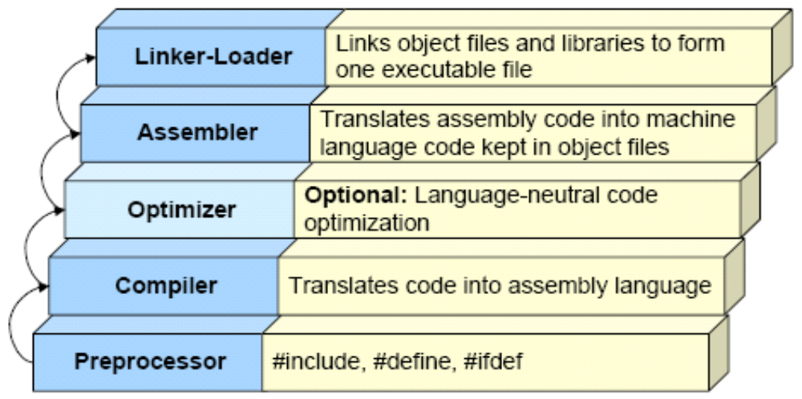
Compilation Process

Slide 5
Basic g++ Examples
g++ hello.cpp
  compile hello.cpp
  produce executable a.out
g++ -o hello hello.cpp
  compile hello.cpp
  produce executable hello
g++ -o hello hello.cpp util.cpp
  compile hello.cpp and util.cpp
  produce executable hello

Slide 6
Separate Compilation
From any source file you can produce an object file to be linked in later to make an executable
g++ -c hello.cpp
g++ -c util.cpp
g++ -o hello hello.o util.o

Slide 7
g++ Options
-c
  compile source files, but do not link
  output is an object file corresponding to source file
-o <file>
  puts output in file called <file>
-g
  include debugging symbols in the output
  to be used later by debugging program (gdb)
-Wall
  display all warnings – program may still compile

Slide 8
g++ Options
-D<macro>
  defines macro with the string ‘1’
-l<name>
  include library called lib<name>.a
-I<path>
  look for include files in the directory provided
-L<path>
  look for libraries in the directory provide
There are default directories in which g++ looks for include files and libraries

Slide 9
Defines in g++
Often programs contain conditional parts based on defines:
#ifdef DEBUG
printf(“value of var is %d”, var);
#endif
You can set preprocessor defines on the command line
g++ -DDEBUG -o prog prog.c

Slide 10
Separate Compilation Scenario
You build a personal database and an interface program called mydb that has a user interface and database backend
Source files: mydb.cpp, user.cpp, database.cpp
Common header file: mydb.h
Executable: mydb

Slide 11
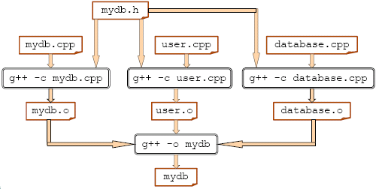
Build Dependencies

Slide 12
Using make in Compile
With medium to large software projects containing many files, it is difficult to:
  Type commands to compile all the files correctly each time
  Keep track of which files have been changed
  Keep track of dependencies among files
make automates this process

Slide 13
Basic Operation of make
Reads a file called [Mm]akefile that contains rules for building a program
  if program is dependent on another file, then that file is built
  all dependencies are built, working backward through the chain of dependencies
  programs are only built if they are older than the files they depend upon

Slide 14
Basic Makefile Example
# Makefile for mydb
mydb: mydb.o user.o database.o
g++ -o mydb mydb.o user.o database.o mydb.o : mydb.cpp mydb.h
g++ -c mydb.cpp
user.o : user.cpp mydb.h
g++ -c user.cpp
database.o : database.cpp mydb.h
g++ -c database.cpp

Slide 15
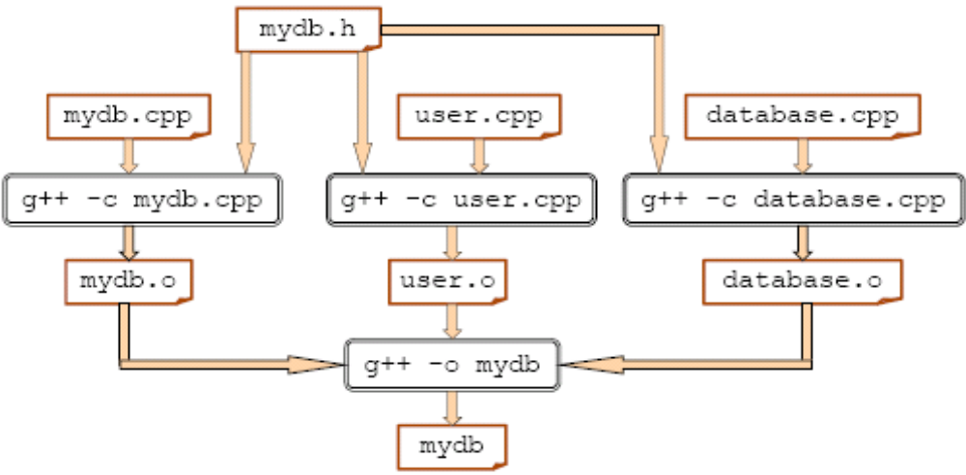
Build Dependencies

Slide 16
Parts of a Makefile
Dependency Lines
  contain target names and dependencies (optional)
  dependencies
    files
    targets
Commands
  below dependency line
  always begin with a tab
  commands to satisfy the dependency

Slide 17
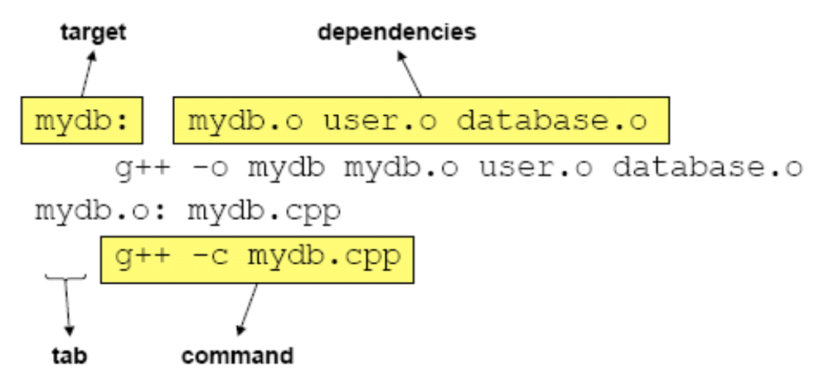
Parts of a Makefile (cont)

Slide 18
Macros and Special Variables
Use macros to represent text in Makefile
  saves typing
  allows easy modification of Makefile
  Assignment
    MACRONAME = macro value
  Usage: ${MACRONAME}
Special variables are used in commands
  $@ represents the target
  $? represents the dependencies

Slide 19
Simplifying the Example
OBJS = mydb.o user.o database.o
CC = /usr/bin/g++
mydb: ${OBJS}
${CC} -o $@ $?
mydb.o: mydb.cpp mydb.h
${CC} -c $?
user.o: user.cpp mydb.h
${CC} -c $?
database.o: database.cpp mydb.h
${CC} -c $?

Slide 20
Invoking make
Be sure that the description file
  is called makefile or Makefile
  is in the directory where the source files are
make
  builds the first target in the file
make target(s)
  builds target(s)
Other options
  -n: don’t run the commands, just list them
  -f <file>: use <file> instead of [Mm]akefile

Slide 21
Other Makefile Notes
Comments begin with a ‘#’
Can be placed at the beginning of a line or after a non-comment line
Lines that are too long can be continued on the next line by placing a ‘\ ’ at the end of the first line

Slide 22
Suffix Rules
Still tedious to specifically tell make how to build each .o file from source file
Suffix rules can be used to generalize such situations
A default suffix rule turns source files into .o files by running the command:
${CC} ${CFLAGS} -c $<
$< refers to the prerequisite (file.cpp)

Slide 23
Simplest Makefile Example
OBJS = mydb.cpp user.cpp database.cpp
CC = /usr/bin/g++
mydb: ${OBJS}
${CC} -o $@ $?

Slide 24
Other Useful Makefile Tips
Include a way to remove intermediate files
clean:
rm –f mydb
rm -f *.o
Include a target to build multiple programs
all:mydb mycalendar myhomework

